Slide 1

Υπολογιστική Κβαντική Φυσική και Εφαρμογές
Bantis Peter
MSc in Computational Physics
Aristotle University of Thessaloniki
19/6/2022

Slide 2
LISTINGs
6.6 - Spontaneous Decay Simulation
6.19 - Double well transitions
6.24 – Feynman Path Integral Quantum Mechanics

Slide 3
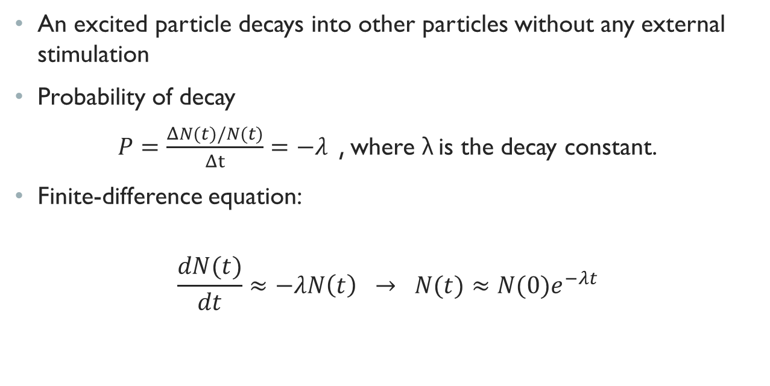
Spontaneous decay simulation
An excited particle decays into other particles without any external stimulation
Probability of decay
$P=\frac{ΔN(t)/N(t)}{Δt}=−λ$ , where λ is the decay constant.
Finite-difference equation:
$$\frac{dN(t)}{dt}≈−λN\left(t\right) → N(t)≈N(0)e^{−λt}$$

Slide 4
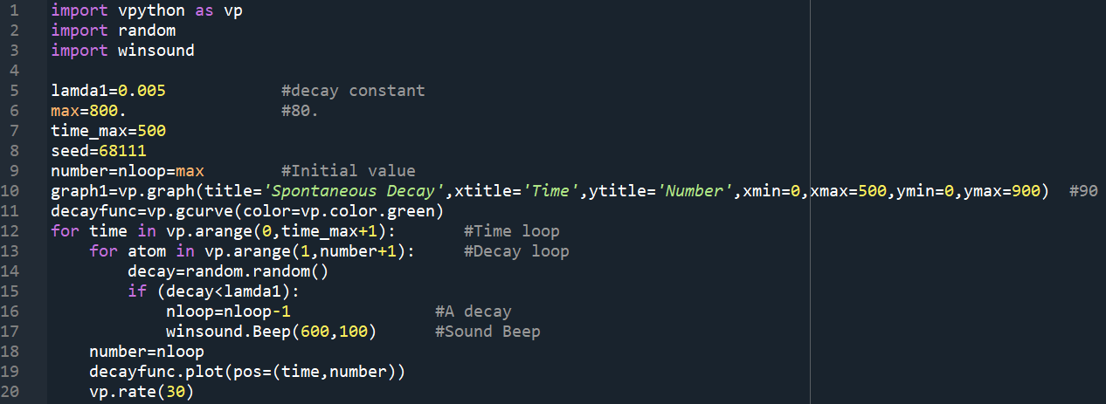
Listing 6.6
CODE
Line 1-3: calling the libraries that will be used
Line 5-9: setting up parameters
Line 10-11: setting up the graph canvas and the curve-function that will be drawn
Line 12: A time loop for each time unit that we will measure the decay
Line 13: A loop that will check the decay for every nuclei (N) contained in the nucleus
Line 14-17: Checking randomly if the decay occurs, if it happens a beep sound is made and the N decreases
Line 19-20: a point is added to the plot and the loop goes on from the beginning

Slide 5
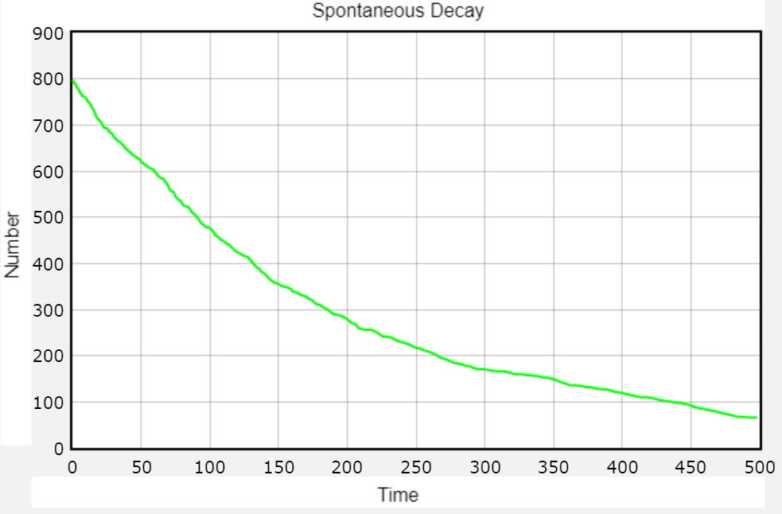
Listing 6.6

Slide 6
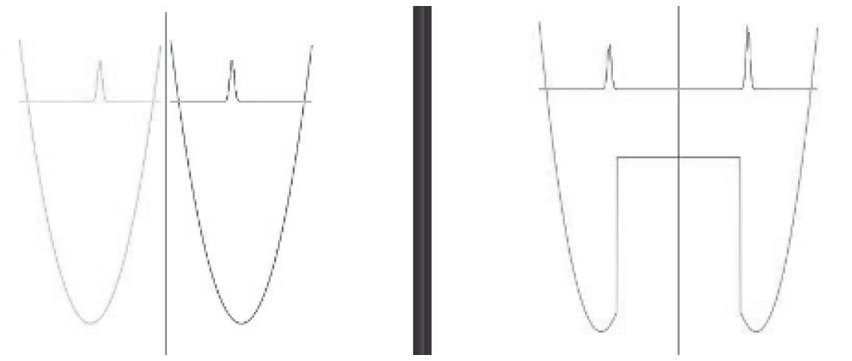
Double well transitions
Given 2 identical potential wells with a barrier of infinite height and finite width between them, a particle placed on one well will remain there for ever (left side).
If there is a perturbation ΔE that lowers the barrier between them, then one can expect that the bound particle will make a transition from left to right side with a certain probability (right side).
Changing the width and the height of the wells affect how the particles jump for one well to another.

Slide 7
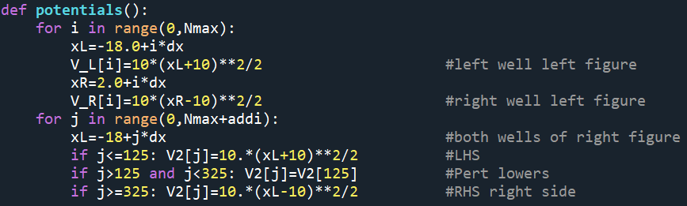
CODE
For def potential():
V_L, V_R are potentials of the separate wells (without perturbation)
V2 is the potential for the perturbation connected wells

Slide 8
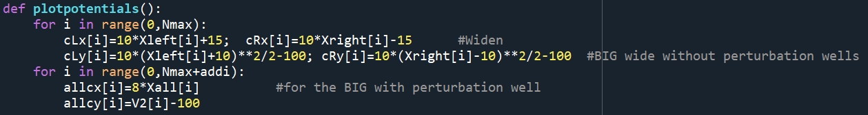
CODE
For def plotpotentials():
cLx, cRx, cLy, cRy are the BIG (widen) without perturbation potential wells - (cLz, cRz → 0)
allcx, allcy is the BIG with perturbation potential well
Xleft, Xright and Xall are the x axis for the small well virtualization

Slide 9
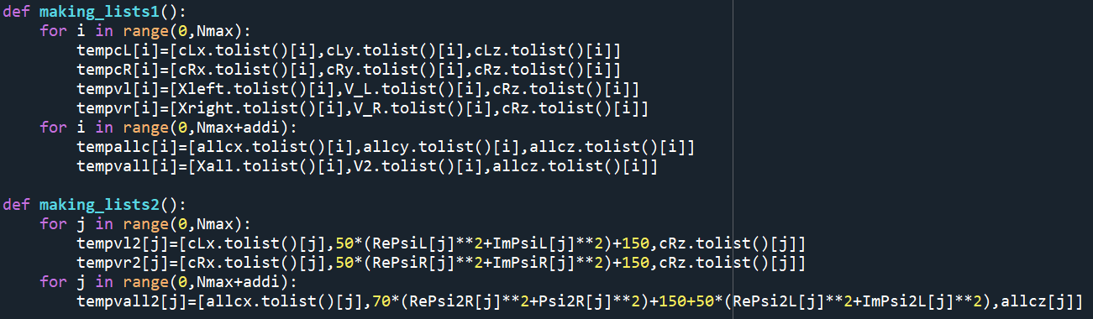
CODE
For def making_list():
Is responsible for wrapping the variables together in order to be plotted

Slide 10
CODE
For main body:
cL, cR plot the big (without perturbation) wells → red - yellow
PlotObj,PlotObjR plot the small (without perturbation) wells → red – yellow
allc plots the big (with perturbation) well → green
PlotAllR plots the small (with perturbation) well → blue
Using the small Xleft, Xright:
I) we compute the initial left Ψ (RePsiL, ImPsiL, Rho=RePsiL²+ ImPsiL²)
For 0-225 (-18 - 0): normal calculation of RePsi2L and ImPsi2L
For 225-450 (0 - 18): RePsi2L=ImPsi2L=0
RhoAL=50*(RePsi2L²+ImPsi2L²)
II) we compute the initial right Ψ (RePsiR, ImPsiR, RhoR=RePsiR²+ ImPsiR²)
For 0-225 (-18 - 0): RePsi2R=ImPsi2R=0
For 225-450 (0 - 18): normal calculation of RePsi2R and ImPsi2R
Rho2R=50*(RePsi2R²+ImPsi2R²)

Slide 11
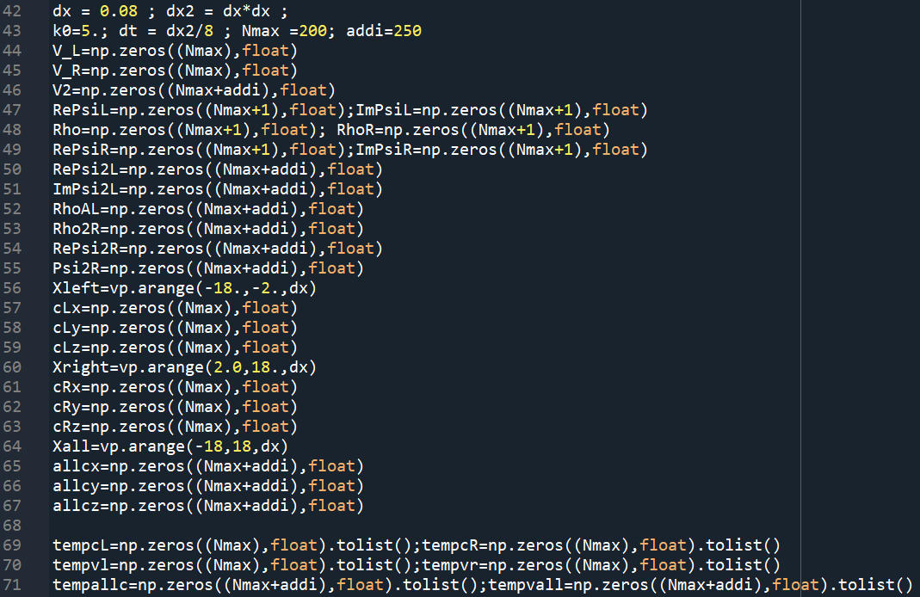

Slide 12
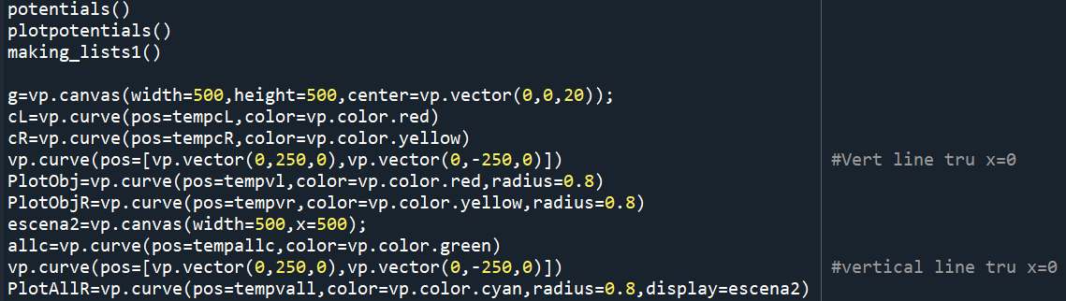
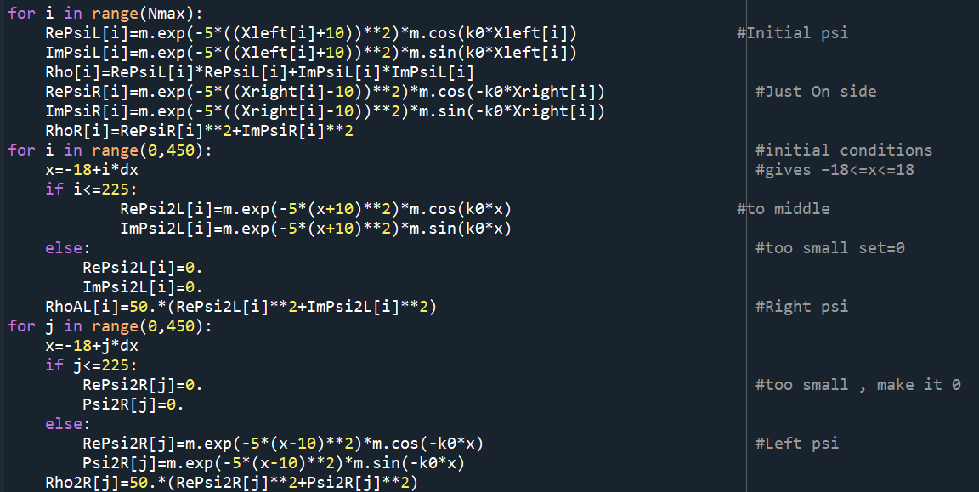

Slide 13
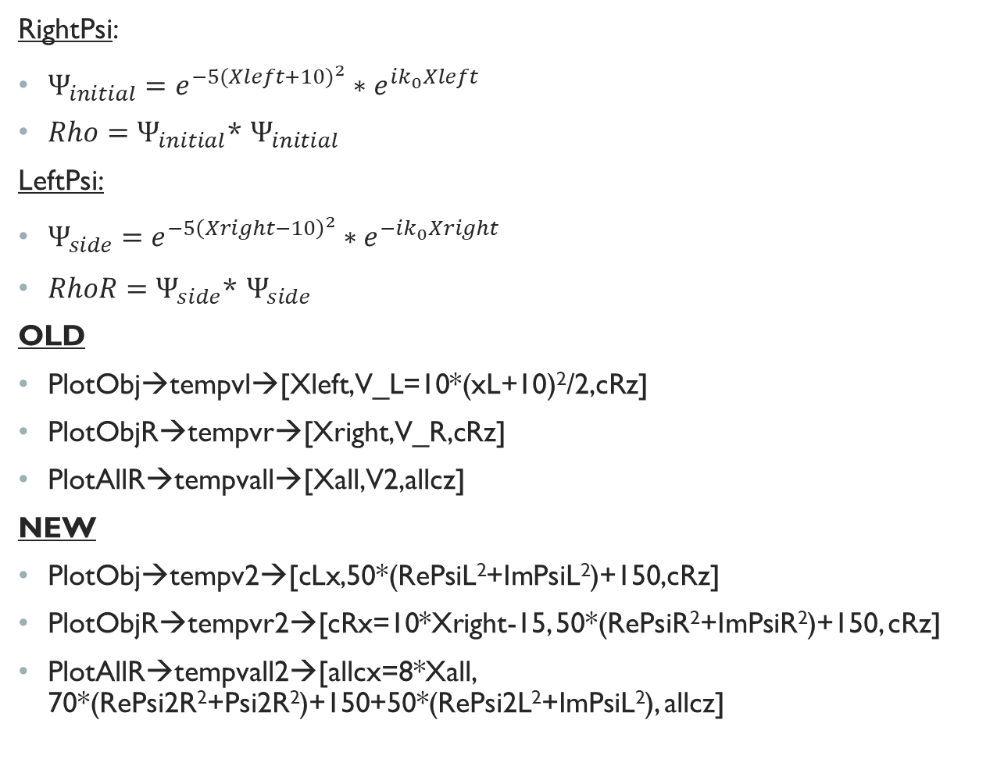
CODE
RightPsi:
$Ψ_{initial}=e^{−5{(Xleft+10)}^{2}}∗e^{ik_{0}Xleft}$
$Rho=Ψ_{initial}$* $Ψ_{initial}$
LeftPsi:
$Ψ_{side}=e^{−5{\left(Xright−10\right)}^{2}}∗e^{−ik_{0}Xright}$
$RhoR=Ψ_{side}\text{*} Ψ_{side}$
OLD
PlotObj→tempvl→[Xleft,V_L=10*(xL+10)²/2,cRz]
PlotObjR→tempvr→[Xright,V_R,cRz]
PlotAllR→tempvall→[Xall,V2,allcz]
NEW
PlotObj→tempv2→[cLx,50*(RePsiL²+ImPsiL²)+150,cRz]
PlotObjR→tempvr2→[cRx=10*Xright-15, 50*(RePsiR²+ImPsiR²)+150, cRz]
PlotAllR→tempvall2→[allcx=8*Xall, 70*(RePsi2R²+Psi2R²)+150+50*(RePsi2L²+ImPsiL²), allcz]

Slide 14
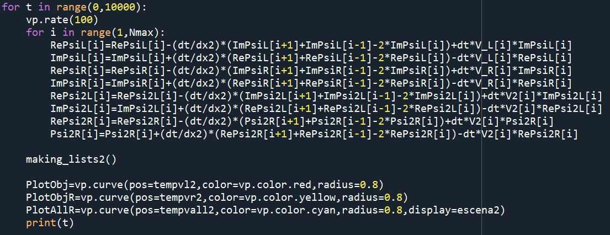
0 - 225 | 225 - 450
RePsi2L=0 ImPsi2L=0 | RePsi2L=0 ImPsi2L=0
RhoAL=50*(RePsi2L²+ImPsi2L²)=0
RePsi2R=0 ImPsi2R=0 | RePsi2R=e^{-5(Xright-10)^2} cos(-k_{o}x) ImPsi2R=e^{-5(Xright-10)^2} sin((-k_{o}x)

Slide 15
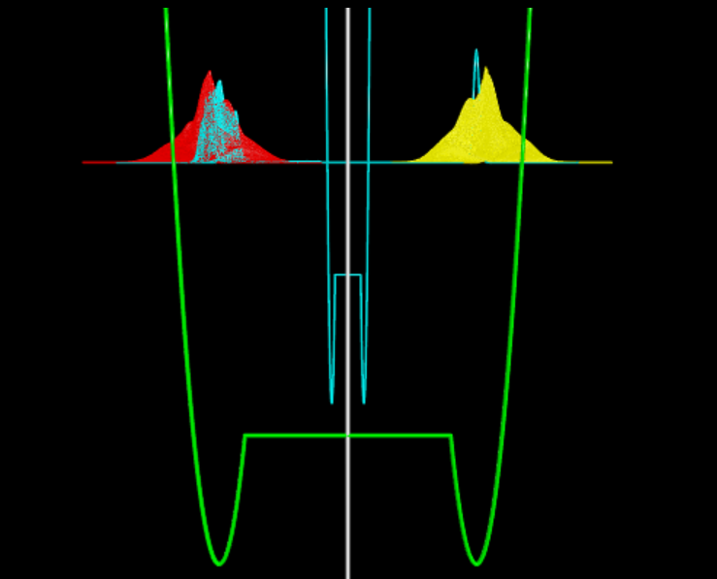
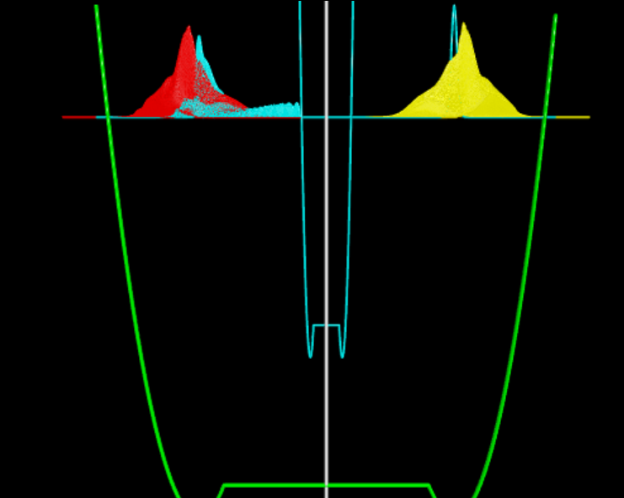
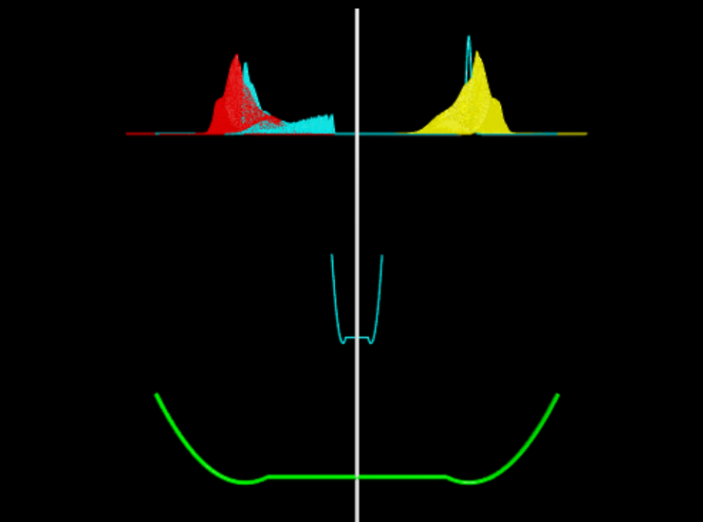
Listing 6.19
Normal perturbation height (5c)
Higher perturbation height (20c)
Lower perturbation height (c)

Slide 16
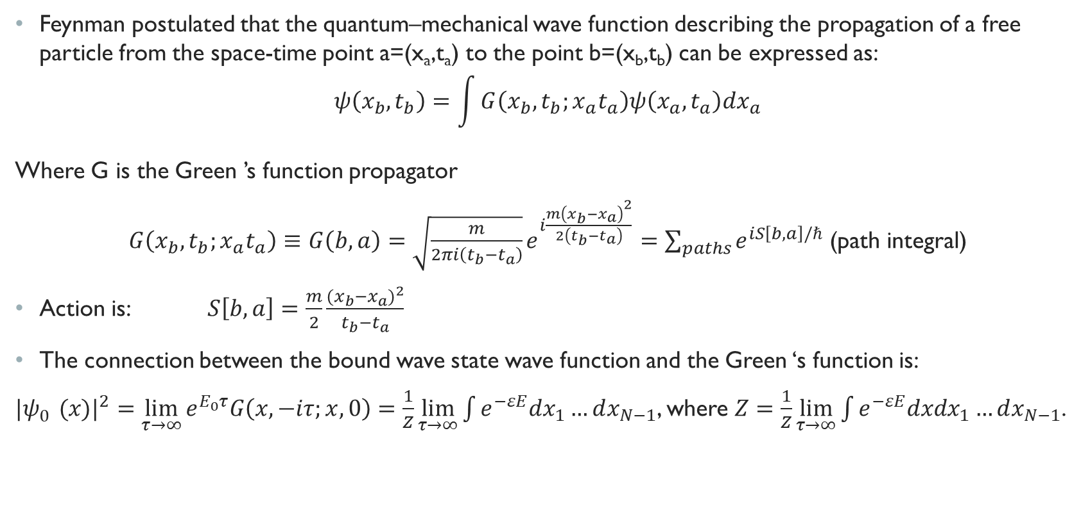
Feynman Path Integral Quantum Mechanics
Feynman postulated that the quantum–mechanical wave function describing the propagation of a free particle from the space-time point a=(x_{a},t_{a}) to the point b=(x_{b},t_{b}) can be expressed as:
$$ψ\left(x_{b},t_{b}\right)=\int{G\left(x_{b},t_{b};x_{a}t_{a}\right)ψ\left(x_{a},t_{a}\right)dx_{a}}$$
Where G is the Green ’s function propagator
$G\left(x_{b},t_{b};x_{a}t_{a}\right)≡G\left(b,a\right)=\sqrt{\frac{m}{2πi\left(t_{b}−t_{a}\right)}}e^{i\frac{m{\left(x_{b}−x_{a}\right)}^{2}}{2\left(t_{b}−t_{a}\right)}}=\sum_{paths}{e^{iS\left[b,a\right]/ℏ}}$ (path integral)
Action is: $S\left[b,a\right]=\frac{m}{2}\frac{{(x_{b}−x_{a})}^{2}}{t_{b}{−t}_{a}}$
The connection between the bound wave state wave function and the Green ‘s function is:
${|ψ_{0}^{}(x)|}^{2}=\lim_{τ→∞}{e^{E_{0}τ}G\left(x,−iτ;x,0\right)=\frac{1}{Z}\lim_{τ→∞}{\int{e^{−εE}dx_{1}…dx_{N−1}}}}$, where $Z=\frac{1}{Z}\lim_{τ→∞}{\int{e^{−εE}dxdx_{1}…dx_{N−1}}}$.

Slide 17
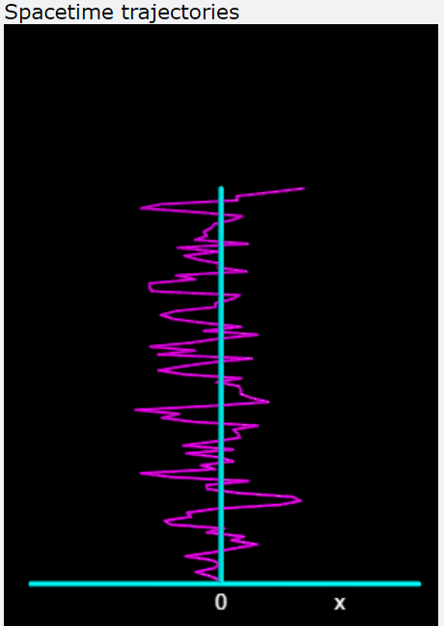
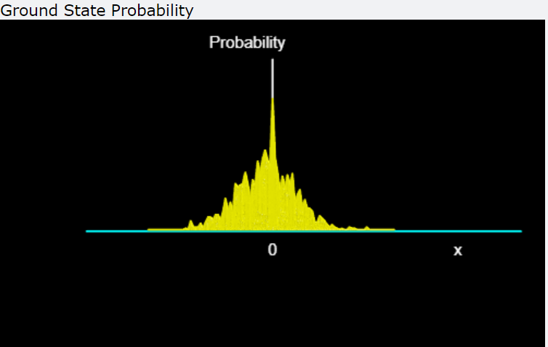
Basically, the program sets up a lattice in space and time so that positions and times are discrete, with integrals evaluated as sums over values at the lattice points, and derivatives evaluated as the differences in values at successive lattice points.
A Metropolis algorithm is used to vary the trajectory and search for the state with lowest energy. The classical path (least action) remains most likely, with nearby paths being less likely to occur.

Slide 18
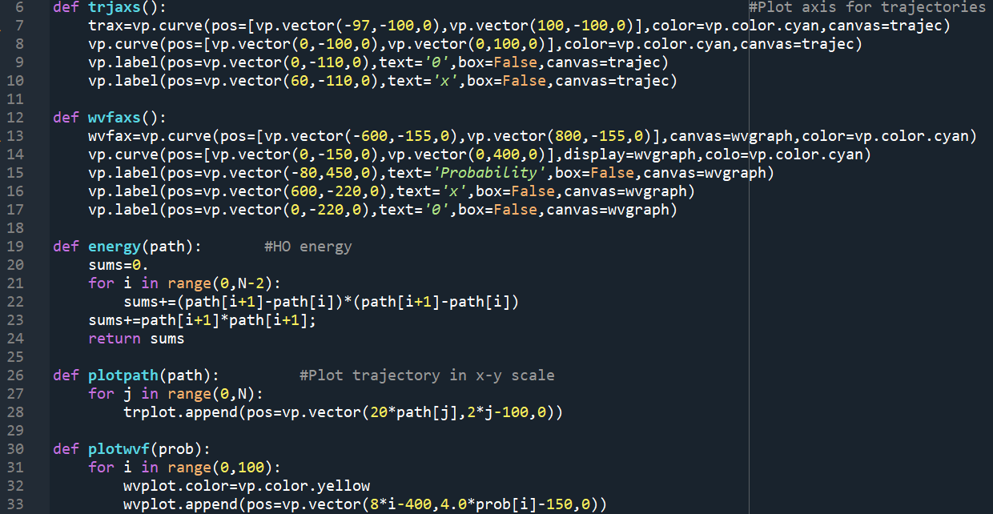
code
Line 6-17: plots the axis for the trajectories and the probability to take a certain route.
Line 19-33: plots the different paths a wave packet can take, their respective probabilities and energy values for each step for every single route

Slide 19
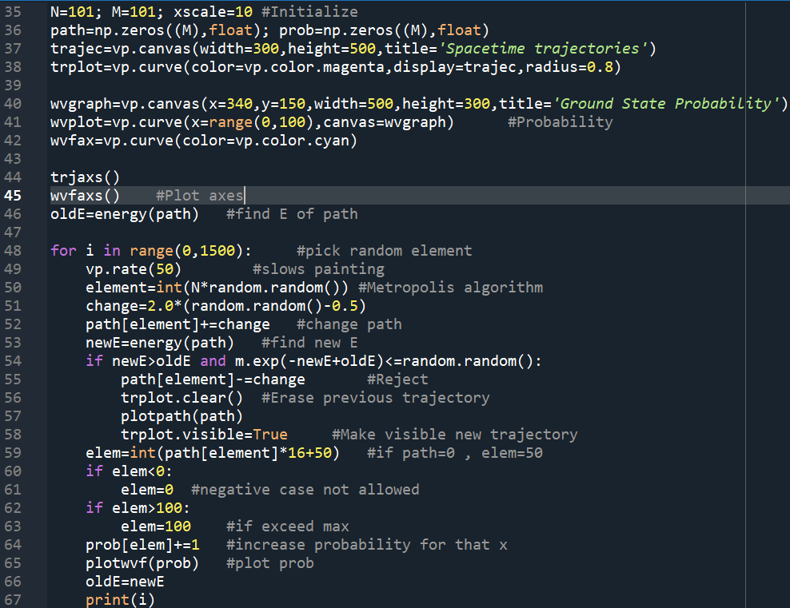
CODE
Line 35-45: the plots are initialized
Line 46: Initial energy is calculated
Line 48-67: random path elements are induced through Metropolis algorithm and new energies are calculated in order to make new trajectories and achieve higher probabilities

Slide 20
Thank you for your time!

